Slide 1
MODULE 3: OPERATIONAL ASPECTS
Truenat® Tests for the Detection of TB and Rifampicin Resistance Central-Level Training

Slide 2
ACKNOWLEDGEMENTS
These training modules were developed as a collaboration between the United States Agency for International Development (USAID) and its Infectious Disease Detection and Surveillance project (IDDS) and the Stop TB Partnership, as part of the introducing New Tools Project (iNTP). The content is based on the Stop TB/USAID/GLI Practical Guide to Implementation of Truenat™ Tests for the Detection of TB and Rifampicin Resistance, together with content provided by Molbio Diagnostics (Module 3). The material was technically reviewed and endorsed by the Global Laboratory Initiative.
All reasonable precautions have been taken by the authors to verify the information contained in this publication. However, the published material is being distributed without warranty of any kind, either expressed or implied. The responsibility for the interpretation and use of the material lies with the reader.
In no event shall the authors be liable for damages arising from its use. Development of this document was made possible with financial support from the United States Agency for International Development. The views expressed herein are those of the authors and do not necessarily reflect those of the U.S. Agency for International Development or the U.S. Government.

Slide 3
Introduction
This module provides information on how to use the Truenat equipment, procedures for conducting tests, and explains infrastructure requirements.

Slide 4
Learning Objectives
By the end of this module, participants should be able to:
List the equipment and supplies needed to run Truenat tests
Describe the procedures for running a Truenat test
Describe the infrastructure requirements for using Truenat equipment
Notes:
Terminal Objective:
At the end of this session, the participant will be able to describe the laboratory aspects of Truenat testing.

Slide 5
01.
Truenat TB PCR Testing
02.
Equipment and Reagents
03.
Truenat Test Procedures
04.
Infrastructure Requirements
MODULE 3: OPERATIONAL ASPECTS- COURSE OUTLINE

Slide 6
Truenat TB PCR Testing
Testing involves the following steps:
Truenat TB test is a chip-based real time polymerase chain reaction (PCR) test for the semi-quantitative detection and diagnosis of Mycobacterium tuberculosis complex bacterial (MTBC) in human sputum samples.
A sputum specimen is liquefied and lysed.
The DNA from the sample is then extracted.
The extracted DNA is amplified.
The amplified DNA is tested.

Slide 7
EQUIPMENT AND SUPPLIES

Slide 8
Equipment
Trueprep® AUTO v2 Universal Cartridge Based Sample Prep Device (Trueprep)
For automated extraction and amplification of DNA

Slide 9
Equipment
Truelab Real Time micro–PCR Analyzer
For performing PCR
Comes in three models:
Truelab® Uno Dx
Truelab® Duo
Truelab® Quattro

Slide 10
Different Models of Truelab Analyzers to Match Anticipated Throughput
 | Throughput per 8-Hour Shift (1 Workday) with Optimized Workflow | Estimated Throughput per 8-Hour Shift (1 Workday) with “Real World” Conditions
1 Truelab® Uno Dx Analyzer + 1 Trueprep extractor | 10-12 specimens | 7-9 specimens
1 Truelab® Duo Analyzer + 1 Trueprep extractor | 20-24 specimens | 15-18 specimens
1 Truelab® Quattro Analyzer + 2 Trueprep extractors | 40-48 specimens | 30-36 specimens
Notes:
Top row (1 Truelab Uno + 1 Trueprep) can be transported in a suitcase, making it easier to transport into communities.

Slide 11
Equipment
Truelab micro-PCR printer
Bluetooth printer, wirelessly prints the results of the PCR tests performed by Truelab® Uno Dx/ Duo / Quattro

Slide 12
Reagents and Consumables
There are three packets that include the reagents and consumables needed to run Truenat

Slide 13
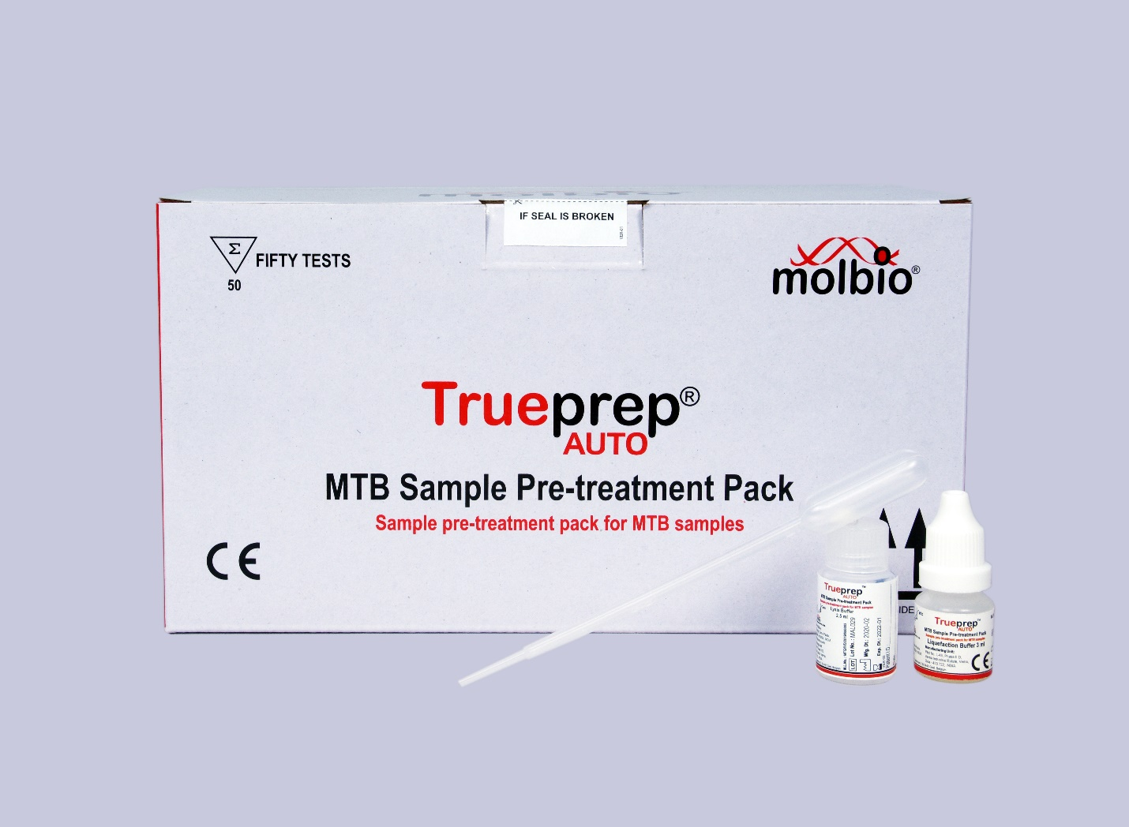
Trueprep® AUTO MTB Sample Pretreatment Pack
Contents:
Graduated transfer pipettes (1 ml)
Lysis buffer bottle (2.5 ml of buffer)
Liquefaction buffer bottle

Slide 14
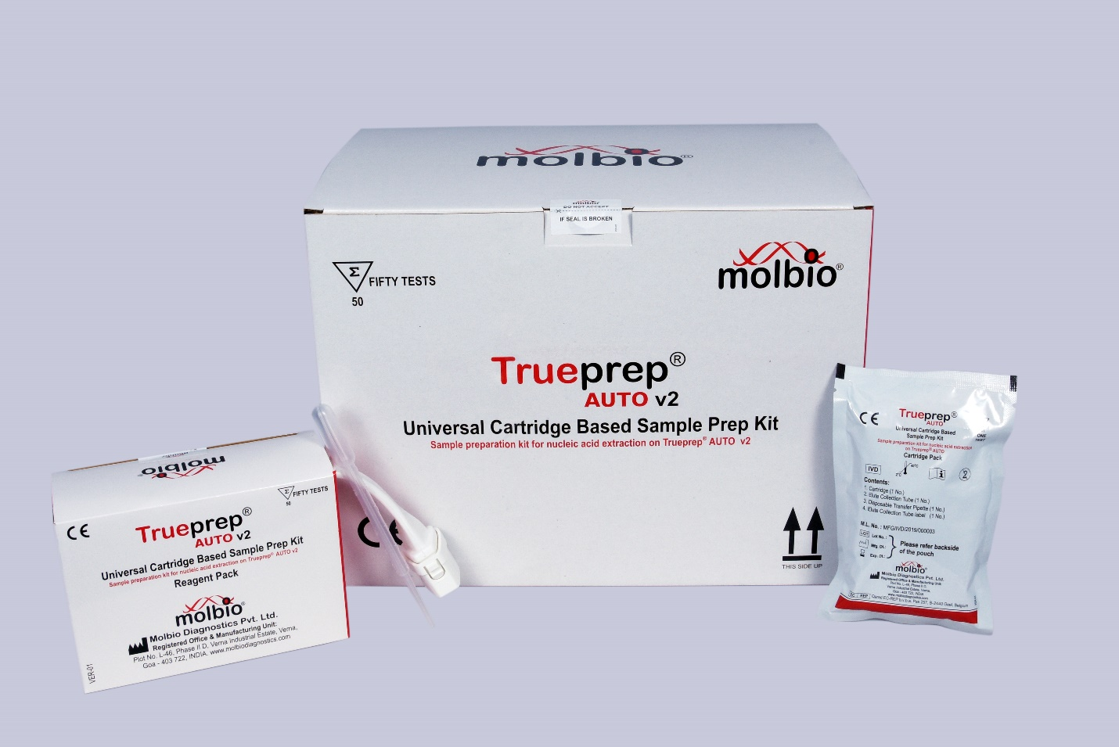
Trueprep® AUTO v2 Universal Cartridge Based Sample Prep Kit (for 25 or 50 tests)
Contents:
Reagent pack
Transfer pipettes (3 ml)
Cartridge pouch
Cartridge
Elute collection tube (ECT)
Transfer pipette
Label for ECT
Notes:
Facilitator Note:
Share with participants:
The Truenat Chip pack has three different chips.
Truenat MTB – for the detection of TB
Truenat MTB Plus – a more sensitive test for TB detection
Truenat MTB-RIF Dx – for the detection of RIF resistance

Slide 15
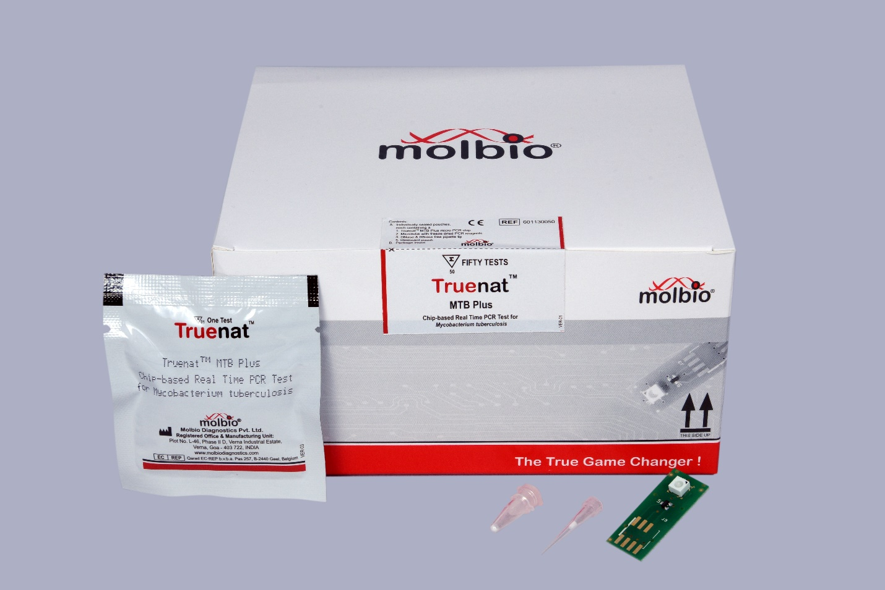
Truenat Chip Pack (for 5, 20, or 50 tests)
Contents:
Truenat chip pouches
Microtube containing freeze-dried PCR reagents
Filter barrier pipette tip
Desiccant pouch
Reminder: Truenat has three types of chips, so three different types of chip packs
MTB
MTB Plus
MTB-RIF Dx
For the detection of TB
A more sensitive test for TB detection
For the detection of RIF resistance
Notes:
Remind participants: Other material required include the Truelab micro printer, Trupete fixed volume 6µl pipette, Truelab microtube stand, gloves, waste disposal containers and bins.

Slide 16
TRUENAT TEST PROCEDURES – Prepare Samples and Extract DNA

Slide 17
Video: Prepare Samples and Extract DNA
Notes:
Facilitator Note:
Share the second part of the video that talks about preparing samples and extracting DNA to participants.
From 2:18 – 8:42
https://youtu.be/ydR2I5S2v3c
Video shows same content as slides 18 – 21, steps 1 – 14.

Slide 18
Prepare Sample and Extract DNA
Equipment
Supplies (Sample Prep Kit)
Reagent pack
Transfer pipettes (3 ml)
Cartridge pouches, each containing:
Cartridge
Elute collection tube (ECT)
Transfer pipette
Trueprep® AUTO MTB Sample Pretreatment Pack
Liquefaction buffer
Lysis Buffer
Disposable transfer graduated pipette - 1ml
Package Insert.
Equipment

Slide 19
Prepare Sample and Extract DNA
1
3
4
Add 2 drops of liquefaction buffer to the sputum cup (Figure 1)
Wear the appropriate gloves for specimen handling
Close the cap and swirl gently to mix (Figure 2)
2
Collect 2-5ml adult pulmonary sputum sample in sputum cup and label with patient details
5
Incubate for 10 minutes at room temperature. If sample is not pipetteable after 10 minutes, incubate for another 5 minutes with swirling at 2-minute intervals

Slide 20
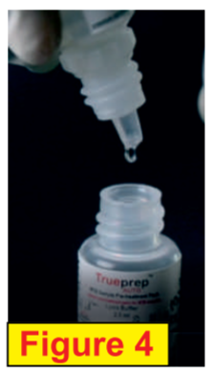
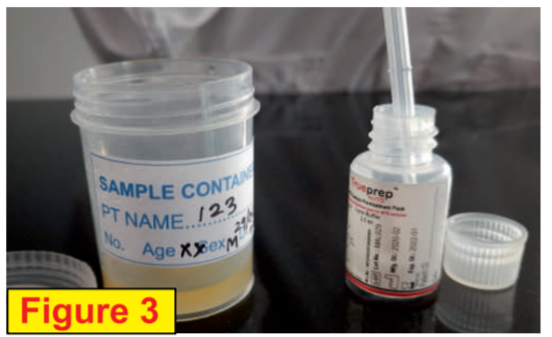
Prepare Sample and Extract DNA
6
7
8
Add 2 drops of Liquefaction buffer into the lysis buffer bottle, swirl gently to mix and incubate for 3-5 minutes (Figure 4)
Transfer 0.5 ml of liquefied sputum sample into the lysis buffer bottle using a 1 ml transfer pipette (Figure 3).
Remove the cartridge from the pouch, label it and place it on the cartridge stand. Take out the elute collection tube (ECT) and label it appropriately. Keep it aside for later use. Keep the elute transfer pipette in the pouch for later use.
Notes:
Remind participants that after liquefaction and lysis, (the pretreatment step), the sample can be stored for up to a week at 30°C. Liquefaction has one main purpose, to decrease viscosity and release the microorganisms from the sputum’s mucin matrix resulting in a homogenous sample. Consequently, you need to be very careful to avoid generating aerosols at this step.

Slide 21
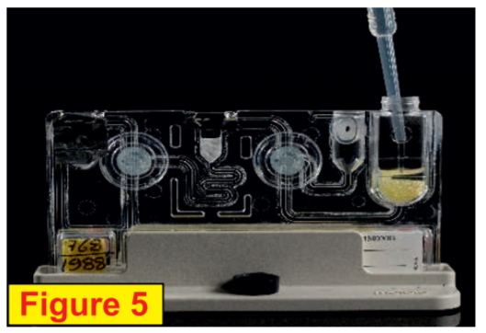
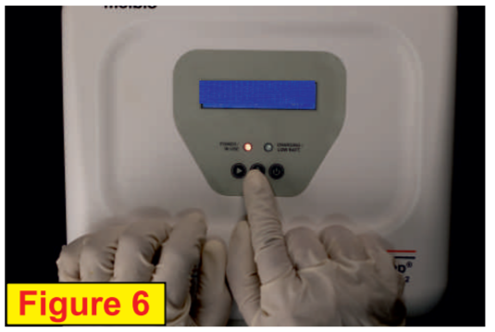
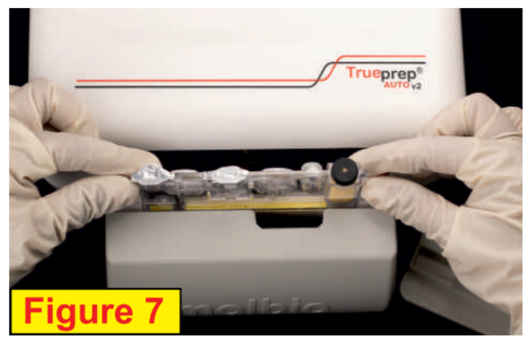
Prepare Sample and Extract DNA
9
10
11
Switch “on” the Trueprep® AUTO v2 device. Press “eject” button to open and gently pull out the cartridge holder (Figure 6).
Transfer the entire contents of the lysis buffer tube to the sample chamber (black cap) of cartridge using 3 ml transfer pipette (Figure 5)
Place the cartridge in the tray in the orientation shown (Figure 7), and gently push to close the cartridge holder. Press “start.”

Slide 22
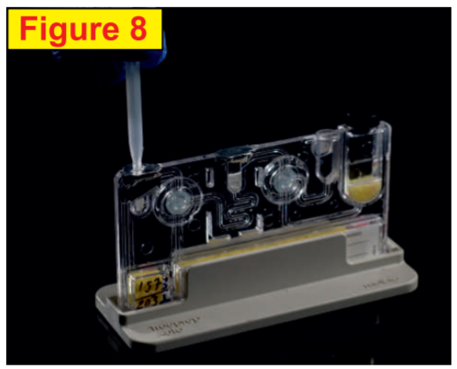
Prepare Sample and Extract DNA
13
14
12
Gently pull out the cartridge holder, remove cartridge, and place it on the cartridge stand.
The device will beep at the end of the DNA extraction process (20 minutes), and the cartridge holder will eject automatically.
Carefully pierce the elute chamber with the provided elute transfer pipette (Figure 8), and transfer the entire elute into the ECT. Discard the transfer pipette and cartridge.

Slide 23
TRUENAT TEST PROCEDURES – Run a PCR TB Test

Slide 24
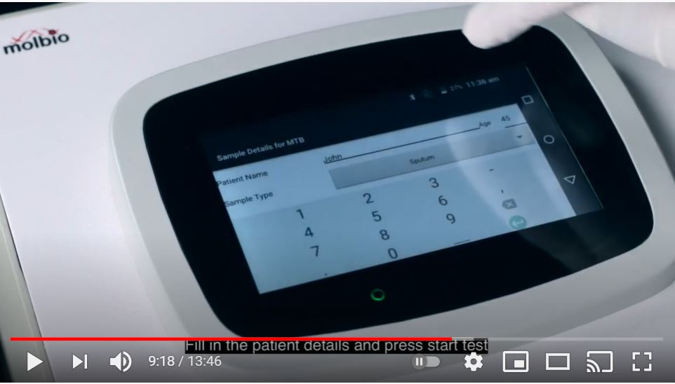
Video: Running a PCR TB Test
Notes:
Facilitator Note:
Share the third part of the video that talks about preparing samples and extracting DNA to participants. Note, Video shows a Duo.
From 8:42 – 12:21
https://youtu.be/ydR2I5S2v3c
Video shows same content as slides 24 – 29, steps 1 – 16.

Slide 25
Equipment & Supplies for Running a PCR TB Test
Equipment
Truelab microPCR Analyzer (Uno, Duo or Quattro)
Supplies (Chip pack)
MTB or MTB Plus Truenat chip
Truepet 6µl Precision Micropipette

Slide 26
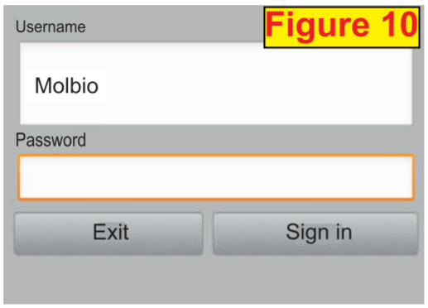
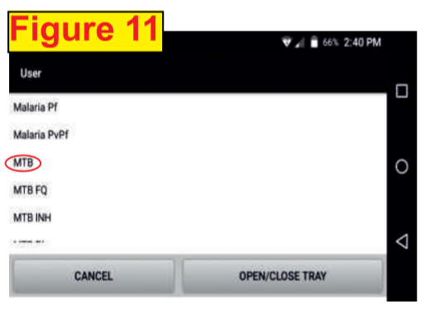
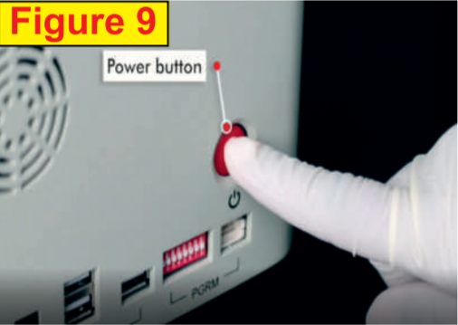
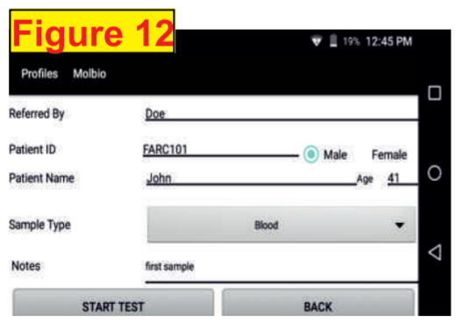
Process Flow
Running a PCR TB Test
1
2
3
Switch “on” the Truelab microPCR analyzer by pressing the red button in the back right corner for 2 seconds. LED will glow in Green (Figure 9). Wait for 30-50 seconds for “boot-up screen” to appear followed by “home screen.”
Select USER ID, enter password. Press “Sign in” to Log in (Figure 10).
Select test profile “MTB” or “MTB Plus” (Figure 11). To confirm selection tap “PROCEED” and enter patient details (referred by, patient ID, gender, patient name & age) (Figure 12).

Slide 27
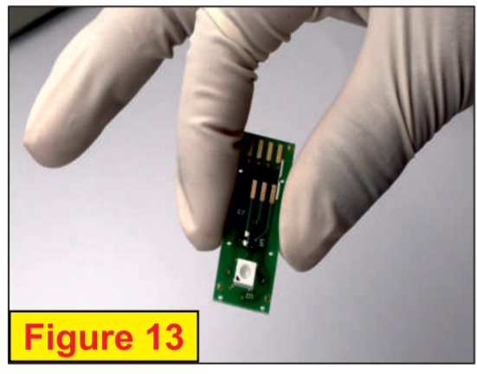
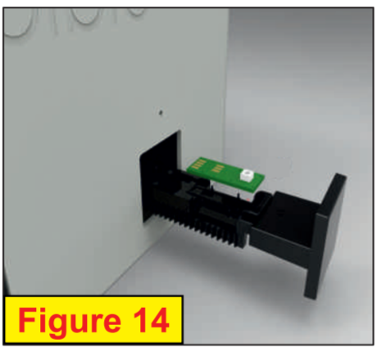
Process Flow
Running a PCR TB Test
4
6
7
Select sample type (sputum).
Open a TRUENAT™ MTB Plus chip pouch
*Pull out the orange desiccant pouch and confirm that it is orange in color.
Gently take out the chip (Figure 13) without touching white well portion and place it on the chip tray by aligning it in the slot provided (Figure 14)
5
Press “START TEST” on the screen. Chip tray opens. “Please Load Sample” will appear.
(Don’t press “YES” until chip loading is complete.}

Slide 28
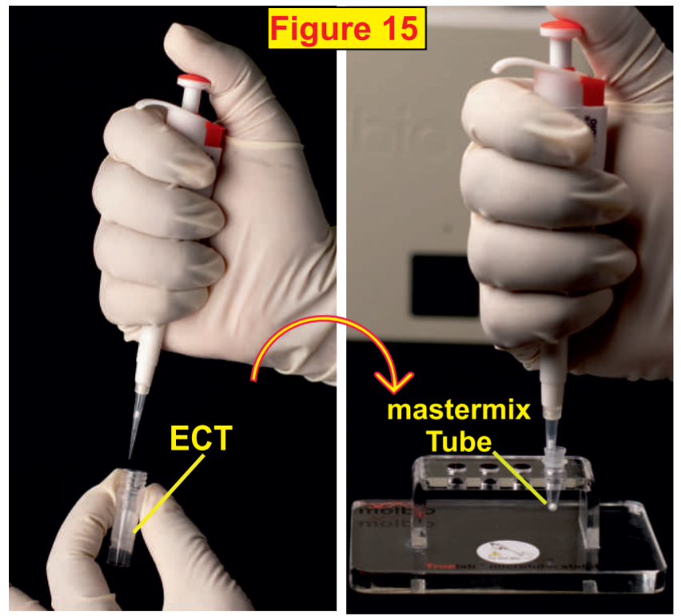
Process Flow
Running a PCR TB Test
8
9
10
Open the mastermix tube, discard the stopper and place the tube in the microtube stand.
*Check for white cake at the bottom of the microtube.
Attach the 6ul micro tip provided in the pouch to the single push pipette.
Transfer 6ul of the elute from ECT into the mastermix tube (Figure 15).
Notes:
* You will want to see the “white cake.”

Slide 29
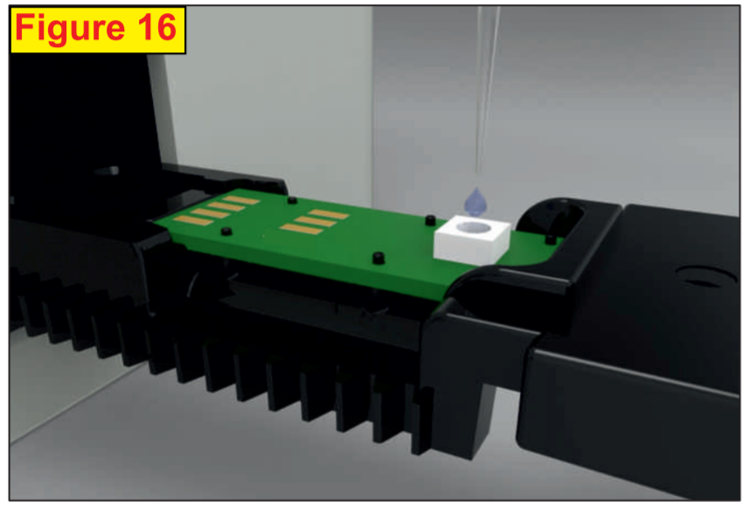
Process Flow
Running a PCR TB Test
11
12
13
Allow the mastermix to stand for 30 SECONDS to get a clear solution.
*Do not mix by tapping, shaking or reverse pipette.
*Do not discard the pipette tip.
Transfer the elute from the mastermix tube to the white reaction well of the chip (Figure 16).
*Avoid spillage of the clear solution outside the white reaction well.
*Discard the pipette tip and mastermix tube.
Click “YES” on the device screen to start the test.
The PCR will be completed in 35 minutes.

Slide 30
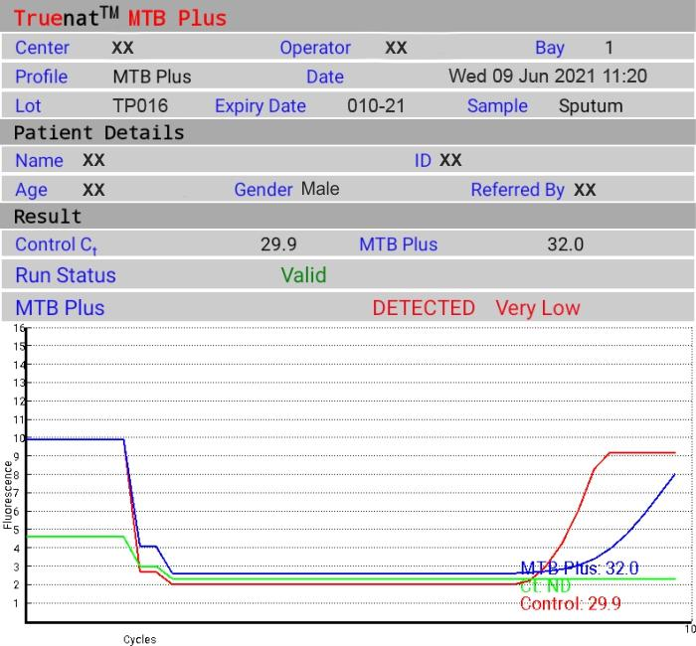
Process Flow
Running a PCR TB Test
14
15
16
Tap the “Open/Close Tray” button to eject the chip tray and discard the used chip immediately after the reaction.
If MTB is detected (Figure 17) test the same elute for RIF resistance using the Truenat MTB RIF Dx chip as a follow-on test. The test takes about 55 minutes.
Optional: Press “Print” to print result page using Truelab® microPCR printer.
Notes:
Remind participants; You can refrigerate the elute in case the test needs to be repeated or you need to run the Truenat MTB/RIF test. After extraction and amplification steps are complete, store any left-over elute in the ECT tube at -20°C.

Slide 31
TRUENAT TEST PROCEDURES – Run a RIF Resistance Test

Slide 32
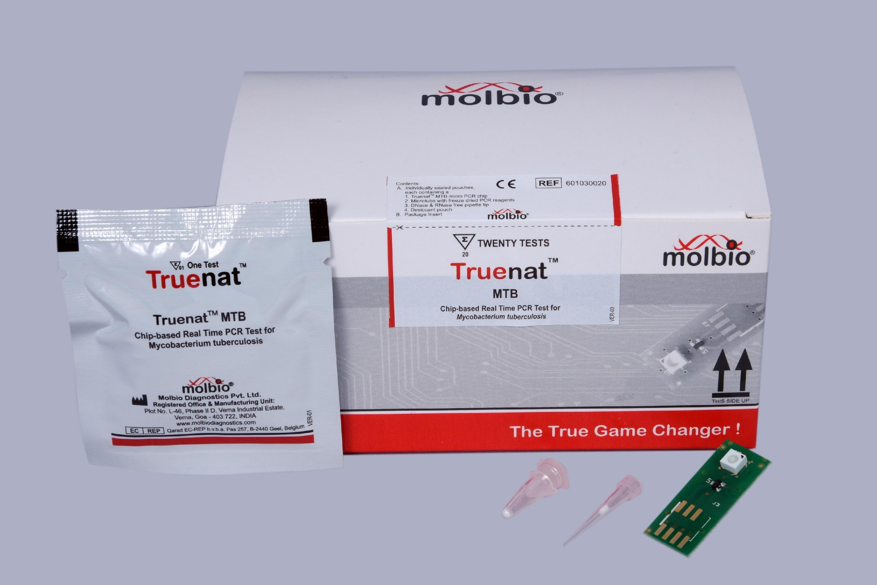
Running a RIF Resistance Test - Equipment
Equipment
Supplies (Chip pack)
Truelab micro PCR Analyzer (Uno, Duo or Quattro)
Truenat MTB-RIF Dx chip
Truepet 6µl Precision Micropipette

Slide 33
Process Flow
Running a RIF-Resistance Test
If MTB is detected in a sample, you should run a RIF resistance test.
A portion of the same DNA eluate can be used to test for RIF resistance using a Truenat MTB-RIF Dx chip.
Start by returning to Step 3 in the PCR TB test process and repeat for RIF-resistance
Select “MTB RIF” as the test type in the Truelab micro PCR Analyzer.
RIF-resistance testing takes an additional 60 minutes
Notes:
Remind participants that the Truenat system is a closed amplification system (i.e., the amplified product is sealed in the chip) and an enzyme system is incorporated in the reaction mix to prevent previously amplified material from getting re-amplified. However, there is still need to follow good laboratory practices to limit contamination. We will discuss this further in Module 5.

Slide 34
Activity: Let’s Practice
Pair off
One practice on equipment
One observe and assist
#
Notes:
Facilitator Note:
This activity will take place if the proper equipment is available. The Facilitator will ask the learners to pair off into groups of 2. Then the Facilitator will tell them that one person should practice with the equipment and perform the steps they just learned without using the materials. The Facilitator will explain that the other person should observe what the practicing learner is doing while following along with the materials explaining the steps. The observing learner should also assist and remind the person practicing of steps as needed. Once finished, they should switch places and repeat.
If equipment is not available:
If equipment is not available, prepare to separate and print all of the steps in the process. Assign a partner to each participant and have them take turns putting the steps in the correct order.

Slide 35
WASTE MANAGEMENT

Slide 36
Waste Management
Truenat tests generate a significant amount of plastic waste
Dispose or incinerate per national guidelines
Decontaminate samples and consumables prior to disposal

Slide 37
Notes on Truenat Procedures – Waste Disposal
The following items should be disinfected in freshly prepared 1% sodium hypochlorite solution and processed as plastic waste:
Transport media tubes
Lysis buffer tubes
Transfer pipettes (1ml and 3ml)
Cartridges
Microtubes
Elute transfer pipettes
Microchips
Gloves (even if contaminated) should also
be disposed of as hazardous waste
Waste disposal color code:
RED

Slide 38
Notes on Truenat Procedures – Waste Disposal
PPE made of fiber material or other materials except disposable plastic should be disposed of as infectious waste, including:
Face masks
Gowns
Caps
Waste disposal color code:
YELLOW

Slide 39
Notes on Truenat Procedures – Waste Disposal
Other items should be disposed of as general waste, including:
Cartridge pouches
Chip pouches
Transfer pipette wrappers
Dessicant pouches
Sleeves
Waste disposal color code:
BLACK

Slide 40
ERRORS AND TROUBLESHOOTING

Slide 41
Errors and Troubleshooting
Molbio has created a Troubleshooting, Alerts and Errors handout for Trueprep and Truelab (included)
Truenat machines will prompt you in case of hardware malfunction or errors encountered when performing a test
Truelab device automatically records data within the system whenever it encounters an error.
Users can generate a log file to send to Molbio to help resolve errors – instructions can be found in the user guide
If a test is in progress when the error occurs, you should create the log file before beginning the next test.

Slide 42
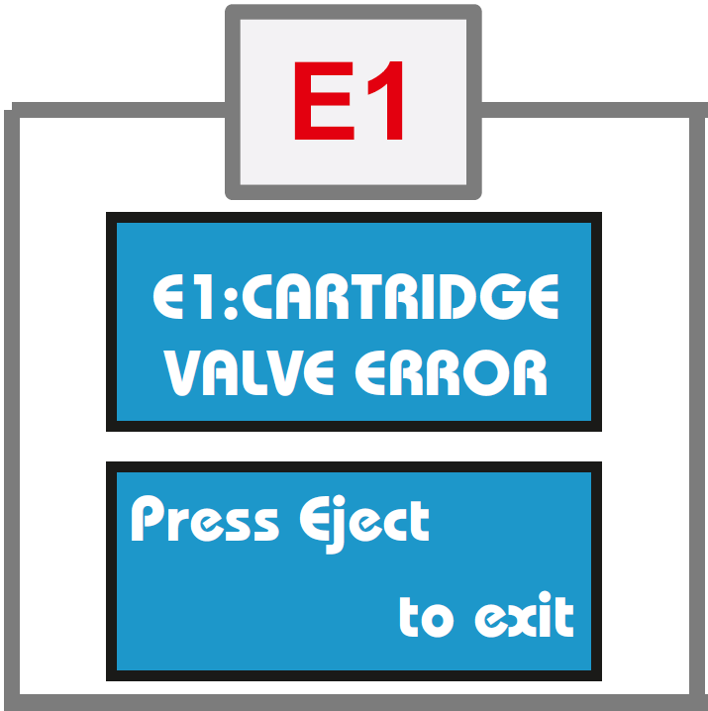
Trueprep Error Messages
Error 1: Cartridge Valve Error
Meaning: Cartridge valve is damaged
Solution: Start over. Process remainder of sample in lysis buffer and load into new cartridge.
Notes:
Facilitator Note:
Distribute the “Troubleshooting, Alerts, and Errors” poster to participants and walk through it together.

Slide 43
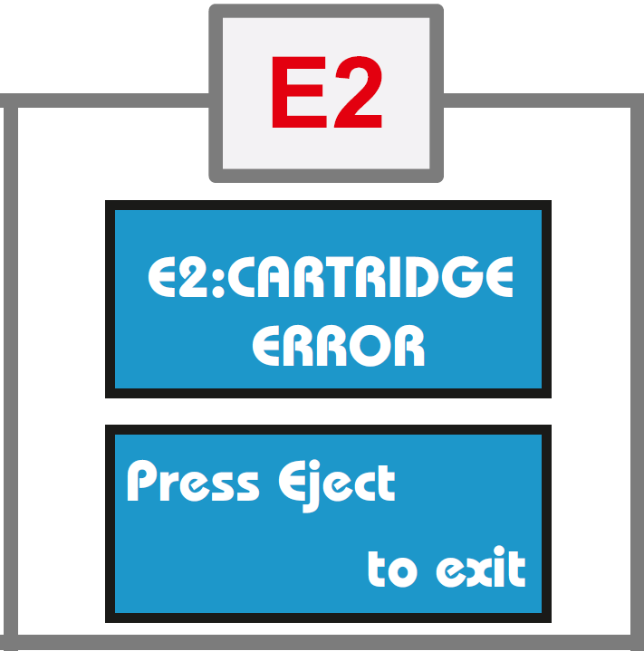
Trueprep Error Messages
Error 2: Cartridge Error
Meaning: Pressure drop error
Solution: Start over. Process remainder of sample in lysis buffer and load into new cartridge.

Slide 44
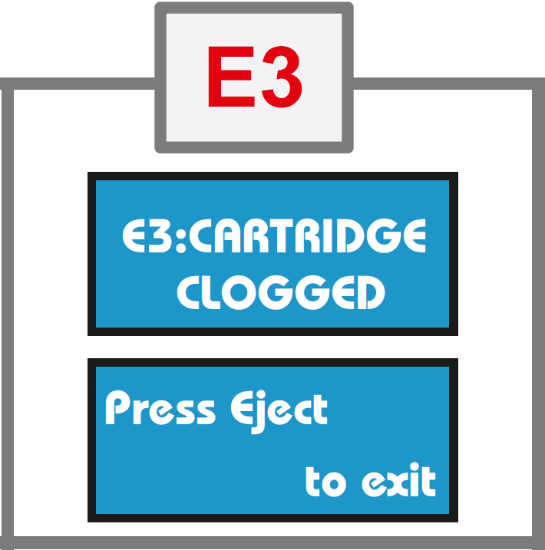
Trueprep Error Messages
Error 3: Cartridge Clogged
Meaning: Sample/specimen is too thick
Solution: Ensure sample is liquefied and pipettable. Repeat extraction with new cartridge/request for new sample.

Slide 45
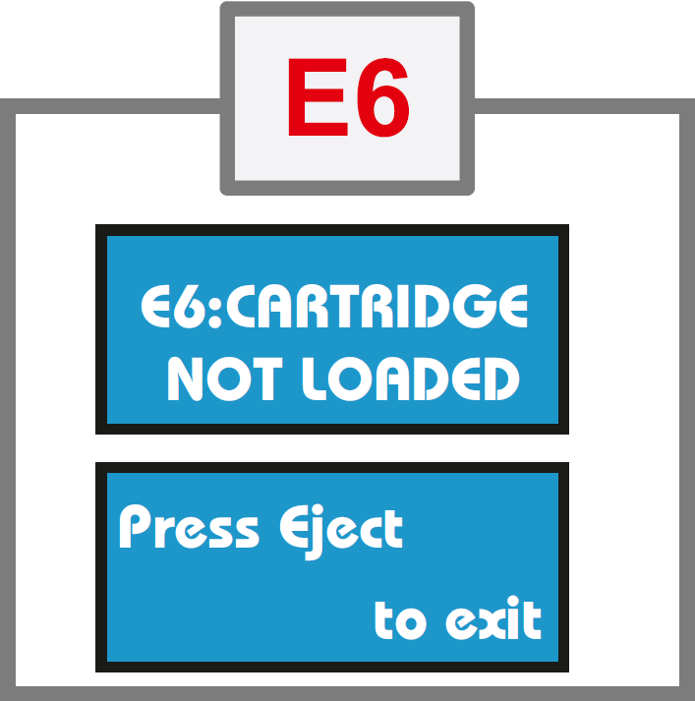
Trueprep Error Messages
Error 6: Cartridge not Loaded
Meaning: Cartridge not detected
Solution: Ensure cartridge is loaded properly in correct orientation
Notes:
There is no E4 or E5 for Trueprep

Slide 46
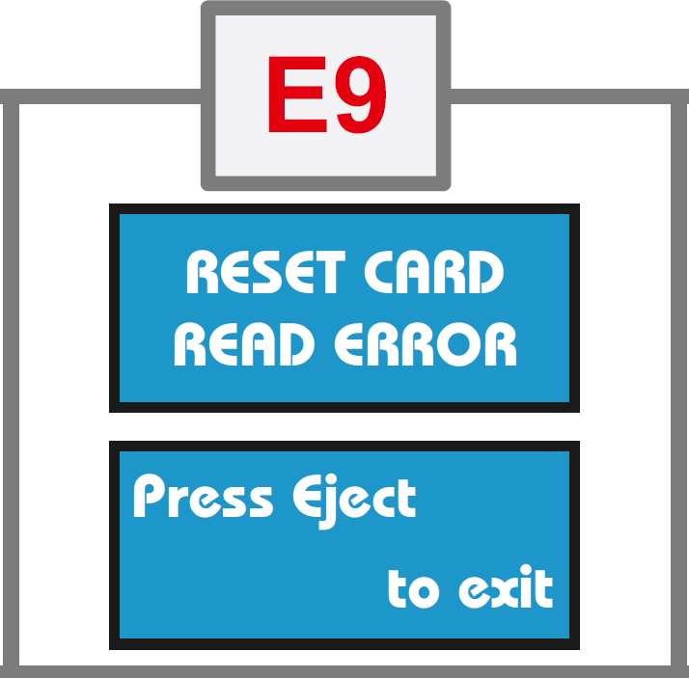
Trueprep Error Messages
Error 9: Reset Card Error
Meaning: Problem with the reset card or QR code reader
Solution: Contact Molbio support
Notes:
There is no E7 or E8 error for Trueprep.

Slide 47
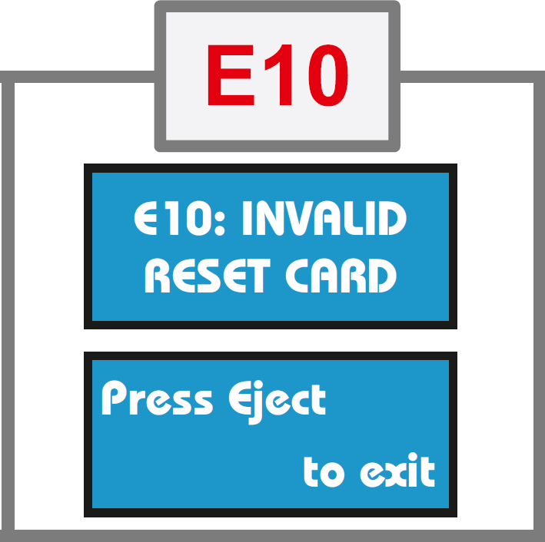
Trueprep Error Messages
Error 10: Invalid Reset Card
Meaning: Problem with the reset card or QR code reader
Solution: Contact Molbio support

Slide 48
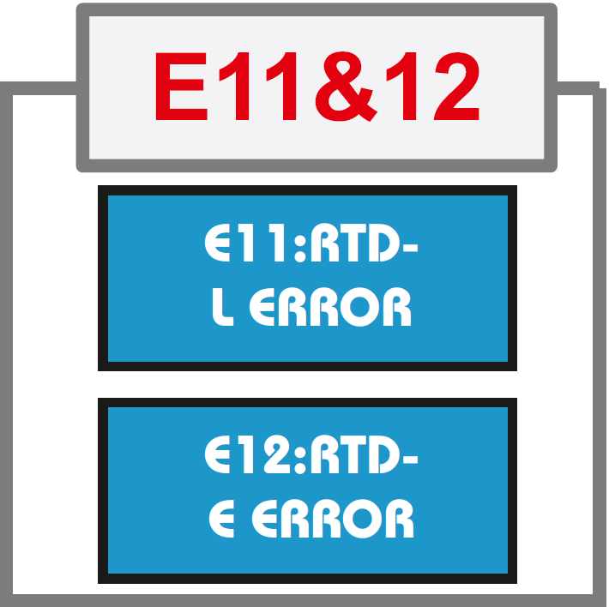
Trueprep Error Messages
Error 11: RTD-L Error
Meaning: Device heater plates not working
Solution: Contact Molbio support
Error 12: RTD-E Error
Meaning: Device heater plates not working
Solution: Contact Molbio support

Slide 49
Truelab Error Messages
Error 1: Thermal cycling error
Error 2: Test stopped manually
Error 3: Incorrect optical profile
Error 4: Runtime error
Error 5: Probe check error
Solution: Repeat the run using a fresh chip and reload the elute by pressing the repeat button. Follow user guidelines for proper loading of elute onto the white reaction well of the chip. Contact the Molbio support team if the problem persists.
Notes:
Facilitator Note:
Distribute the “Troubleshooting, Alerts, and Errors” poster to participants and walk through it together.

Slide 50
Truelab Error Messages
INVALID
Meaning: Internal control did not amplify in PCR or improper sample extraction.
Solution: If the test result is Invalid, process the sample again and run elute using another chip. If the result is invalid again, request a fresh sample and repeat testing. Contact the Molbio support team if the problem persists.
Notes:
Facilitator Note:
Distribute the “Troubleshooting, Alerts, and Errors” poster to participants and walk through it together.

Slide 51
Truelab Alert Messages
Unable to read chip information
Meaning: Analyzer was unable to read chip memory.
Solution: Check if chip was loaded properly into the tray.
Remove the chip and re-select the profile from Status Screen and repeat the steps.
If message reappears, load a new chip and re-load the elute again.
Notes:
Facilitator Note:
Distribute the “Troubleshooting, Alerts, and Errors” poster to participants and walk through it together.

Slide 52
Truelab Alert Messages
Could not initialize. Please try again.
Meaning: The system was unable to establish an internal connection.
Solution: Attempt the test again by using a new chip and re-loading the elute again.
Notes:
Facilitator Note:
Distribute the “Troubleshooting, Alerts, and Errors” poster to participants and walk through it together.

Slide 53
Truelab Alert Messages
Chip is already used
Chip loaded is expired
Meaning: User loaded a used chip or expired chip in the tray.
Solution: Use a fresh chip and re-load the elute.
Notes:
Facilitator Note:
Distribute the “Troubleshooting, Alerts, and Errors” poster to participants and walk through it together.

Slide 54
Activity: Fix the Error
#
Notes:
Facilitator Note:
This slide will be an activity to let learners apply what they just learned. The bullets won’t be on screen to start. Facilitator will share short scenarios and ask participants to determine how to fix an error message through a group discussion. After the class comes to a consensus on scenario 1, the Facilitator will then have the first answer/bullet animate onto the screen. Same process will happen for each of the remaining scenarios and bullets.

Slide 55
INFRASTRUCTURE REQUIREMENTS

Slide 56
Power
Equipment is battery operated for up to 8 hours
Electric or solar power required for re-charging
Electric power allows charging and testing at the same time
Devices are able to operate within the 100-240 voltage range
Electrical power may be needed to cool storage rooms in areas where temperature exceeds 30⁰ C
Chips can be stored at up to 45⁰ C for up to 1 month and up to 40⁰ C for 6 months
Notes:
Facilitator Note:
Share with participants
Power
Devices are able to operate within the 100-240 voltage range
No additional voltage stabilization is required in settings with instabilities or low voltage.
Electric power may be needed to cool rooms in areas where temperatures exceed 30°C
For proper storage of test chips
For refrigerating sputum samples

Slide 57
Solar Power (Optional)
Panel: 150 Watts. Dimensions (LxWxH): 1490 x 665 x 35 mm
Battery: 12V 18Ah Lead Acid
Solar Charge Controller + DC to DC boost converter (12V to 170V, 100 Watts)
Controller and converter available from Molbio; panel, battery and installation to be locally sourced

Slide 58
Room Layout
Trueprep and Truelab instruments should be installed on a flat, stable surface
Minimum surface dimensions of 1.2 m by 0.6 m
Install away from instruments that cause vibrations or electromagnetic interference
Install away from machines that generate or radiate heat and out of direct sunlight
Three well-grounded electrical outlets are recommended for operating or charging the instruments at once

Slide 59
Ambient Temperature
Equipment | Ambient Condition
Trueprep® AUTO v2 Device and Truelab Analyzers | Temperature: 15°C – 40°C
Chips | Storage temperature is up to 45°C for up to one month; 40°C up to six months; and up to 2 years when at 30°C
Reagent packs | Storage temperature: 2°C – 40°C for 2 years

Slide 60
Dust
The Truelab® Real Time microPCR Analyzer does not require air intake to allow for the PCR process, so Truenat use will not be compromised in dusty settings.
The manufacturer recommends installing the instruments in a dust-free environment when possible.

Slide 61
Biosafety
Truenat TB tests require the same biosafety precautions as microscopy, Xpert MTB/RIF or TB-LAMP
Take standard precautions in handling sputum samples

Slide 62
Security
Equipment should be kept in a secure, lockable facility
Equipment can be transported in the portable Truelab Real Time PCR Workstation Field case

Slide 63
Preventive Maintenance
Daily maintenance
Clean work area
Discard used chips and cartridges
Monthly maintenance
Disinfect instrument surfaces
Clean Truelab bays
Temperature calibration
Verification of the fixed 6µl pipette
As necessary
Flush protocol for the Trueprep instrument
Spillage tray or linear motion guide tray replacement
Slider glass replacement -indicate bay
An example of a Preventive Maintenance Log can be found in Annex 4 of the Truenat Implementation Guide
Notes:
Minimal preventable maintenance is needed for Truelab and Trueprep equipment.

Slide 64
ACTIVITY –PREVENTIVE MAITENANCE
How would you carry out daily, monthly and as necessary preventive maintenance when performing tests with a Truelab platform?
Notes:
Daily maintenance
Clean work area
Discard used chips and cartridges
Monthly maintenance
Disinfect instrument surfaces
Clean Truelab bays
Temperature calibration
Verification of the fixed 6µl pipette
As necessary
Flush protocol for the Trueprep instrument
Spillage tray or linear motion guide tray replacement
Slider glass replacement -indicate bay

Slide 65
RECORDING TESTING ACTIVITIES

Slide 66
Recording Testing Activities
May be necessary to make revisions to requisition forms (specimen examination request) for Truenat
Laboratory and clinical registers may also need to be modified to record the results of Truenat tests
Forms and registers being used for the Xpert MTB/RIF test may be suitable for use with the Truenat TB tests.
Truenat tests generate the same type of information as Xpert (e.g., MTB detected or not detected)

Slide 67
Recording Testing Activities
**If lab request forms and registers, rejection logs, or other recording forms have already been developed – this is a placeholder for explaining them

Slide 68
WARRANTY

Slide 69
WARRANTY CONDITION
To activate the warranty, the customer must fill and sign the installation report & warranty certificate and return the slip to Molbio Diagnostics Private Limited
Molbio Diagnostics Private Limited, guarantees that all its instruments are free from manufacturing defects or faults.
Molbio undertakes repair or free of charge substitution/replacement of spare part which may be found to have manufacturing defects.
Repair and interventions carried out during the period of the warranty do not extend or renew the period of warranty.
The repairs of the instrument will be carried out onsite (except in case of major repairs where the instruments will have to be shipped to Molbio’s head-office or Country Partner’s location) by Molbio’s authorized engineer/country partner representatives only.
In the event Molbio is unable to repair the instruments onsite, it reserves the right to recall the instrument for repair at the head office/country partner locations if major/frequent problem has been observed in the instrument.

Slide 70
TERMINATION OF WARRANTY
The warranty shall be terminated at the end of the warranty period & also in the following cases:
Where attempts to make repairs or alterations have been made by unauthorized person &/or with spare parts which are not originals.
Alteration have been made to the serial number of the product on either the certificate or on the instrument.
The instrument is transferred to a new location without following the appropriate processes as per Installation Qualification (IQ)/ Operational Qualification (OQ)/ Performance Qualification (PQ) or prior written approval from Molbio Diagnostics Private Limited or Molbio Country Partners
In order to transfer an instrument to a new location without termination of the warranty, contact Molbio/Molbio local partners to inform them and take their assistance. Molbio/Molbio local partners will request that you confirm that the new site will conform with the pre-installation requisites (see next slide). The pre-installation requisites will need to be checked again once the transfer has taken place.
This point about transferring to a new location does not apply to a situation when an end user has initially installed the instruments in a mobile vehicle that moves from place to place, and the instruments remain installed on the same bench in the mobile vehicle

Slide 71
PRE-INSTALLATION REQUISITES
Check for the following parameters with respect to location of installation:
Workstation should be positioned on the workplace/table/workbench in an upright position on flat and dry surface.
Installation site should be away from direct sunlight or any radiating or heating apparatus.
Installation area should be free of devices which may cause vibrations or electromagnetic interference.
Installation site should be free from any atmosphere of potentially explosive liquids, vapors and gas.
Room temperature should be between 15ºC and 40ºC.
Relative humidity (RH) should be between 10% - 80% (non-condensing).
Power Supply minimum requirement is 100 to 240V/5Amps AC for all the devices as AC to DC adapters which are provided along with the device for charging an Inbuilt Battery can function.
Notes:
Templates for pre-installation and site readiness are available in as annexes in the Truenat implementation guide.
As discussed in the previous slide, the customer (you), checks and confirms that the following pre-installation requisites are met.

Slide 72
PRE-INSTALLATION REQUISITES
Check for the following parameters with respect to location of installation:
Check for Earthing Voltage which should be less than 5V
Dimensions of our Devices are as Follows:
Trueprep Autov2: 215 mm x 235 mm x 115 mm
Truelab Quattro: 400 mm x 242 mm x 159 mm
Truelab Duo: 240 mm x 242 mm x 159 mm
Truelab UnoDX: 248 mm x 185 mm x 112 mm
Table space requirement should be after taking other accessories like MicroTube stand, Cartridge stand, Thermal Printer (small Size) and MicroPipette (6uL) Stand also into consideration. Minimum table dimensions:
Truelab Duo Workstation with Accessories: 118 cm X 60 cm
Truelab Quattro Workstation with Accessories: 148 cm x 60 cm

Slide 73
OTHER WARRANTY INFORMATION
Validity and duration:
This warranty shall be considered valid only on the condition that this certificate is accompanied by the installation report.
The warranty is valid for a period of 12 months from the date of successful installation or 14 months from the date of invoice whichever is earlier.
The following damage & faults are not covered under this warranty:
Damage deriving &/or originating from an insufficient or inadequate electric circuit or from the area where the instrument is set up & used.
Breakdowns caused by careless handling, imprudence, lack of expertise & in any case caused by lack of skill or any degree of negligence on the part of the operator.
Damage, defects & faults deriving from unexpected events, accidents during transport by the purchaser, due to FORCE MAJEURE & in any case, due to situation which can in no way be attributed to manufacturing &/or material defects.
Molbio shall accept no responsibility whatsoever for damage either directly or indirectly to persons or materials from the use of the instrument.

Slide 74
SUMMARY
Truenat is a chip-based real-time polymerase chain reaction (PCR) test that involves four steps:
A liquefied lysed sputum specimen
Extracting DNA from the sample
Amplifying the extracted DNA
Testing the amplified DNA
Three pieces of equipment are used for Truenat:
Trueprep
Truelab (Uno, Duo, or Quattro)
Optional microPCR printer
Procedures for operating Truenat are summarized in an easy-to-follow job aid
Truenat equipment requires minimal infrastructure and minimal preventive maintenance

Slide 75
Knowledge Check – Question 1
1. There are packets that include the reagents and consumables needed to run Truenat. What are they?
Notes:
Answer: 3

Slide 76
Knowledge Check – Question 2
2. What are the three versions of the Truelab Real Time micro–PCR Analyzer? What is the difference between them?
Notes:
Answer: uno, duo, and quattro

Slide 77
Knowledge Check – Question 3
3. What are the monthly maintenance requirements for Truelab and Trueprep equipment?
Notes:
Answer:
Disinfect instrument surfaces
Clean Truelab bays
Temperature calibration
Verification of the fixed 6µl pipette

Slide 78
THANK YOU

